Slide 1
Spatiotemporal Evolution and Driving Mechanisms of UK Electric Vehicle Adoption
A Data-Driven Roadmap to the 2030 Decarbonisation Targets
Presenter: Group 1 (Chenxi Hu, Jipeng Song, Yiding Wang, Yuan Lu)
Date: 11/03/2026

Slide 2
Background & Research Scope
Background
Questions
Emissions Context: Transport accounts for 29.1% of UK greenhouse gas emissions (2023).
The ZEV Mandate: Automakers are legally required to achieve 80% zero-emission vehicle sales by 2030.
Research Pillars: Spatiotemporal evolution, socio-economic/infrastructure driving mechanisms, and 2030 predictive forecasting.
Spatiotemporal Evolution: Do EV ownership levels and growth rates show significant variation?
Socio-economic Drivers: How do wealth and government incentives impact penetration?
Infrastructure Causality: Is there a mutual relationship between charging deployment and EV uptake?
Target Feasibility: Does the data suggest the 2030 targets are mathematically achievable?

Slide 3
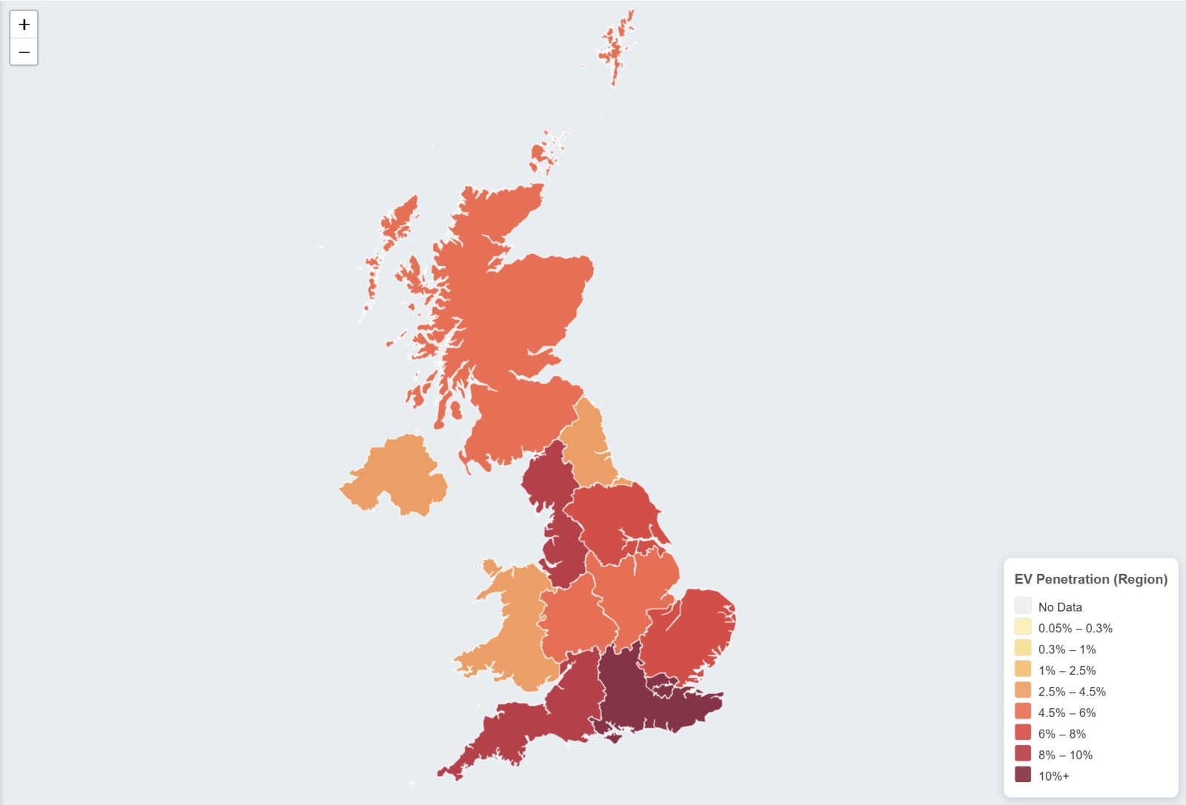
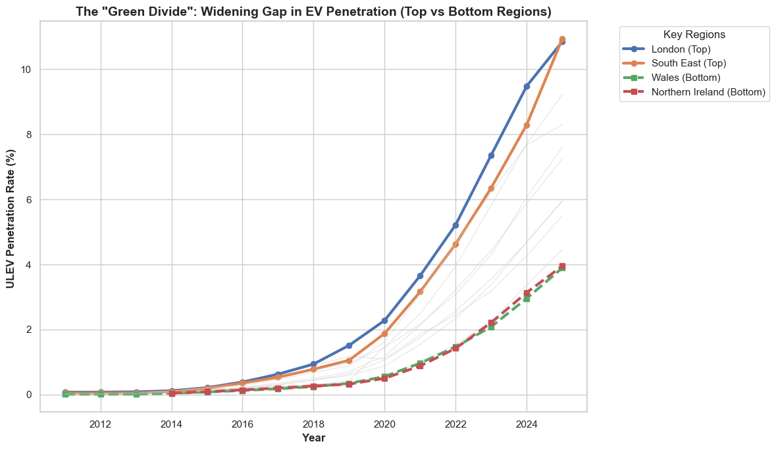
The "Green Divide"
Observation: EV adoption exhibits severe geographic inequality rather than uniform national growth.
The "Green Divide": Free-market dynamics have rapidly accelerated adoption in affluent areas (London/Southeast) while leaving less-developed regions (Northern Ireland/Wales) behind.
The Threat: By 2025, the absolute penetration gap widened to nearly seven percentage (7%) points, threatening national targets.

Slide 4
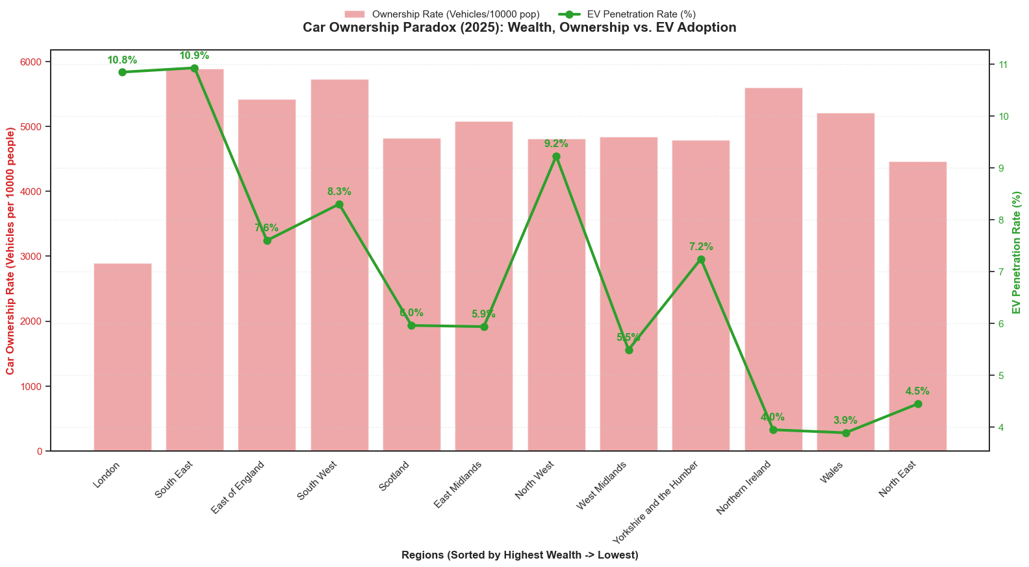
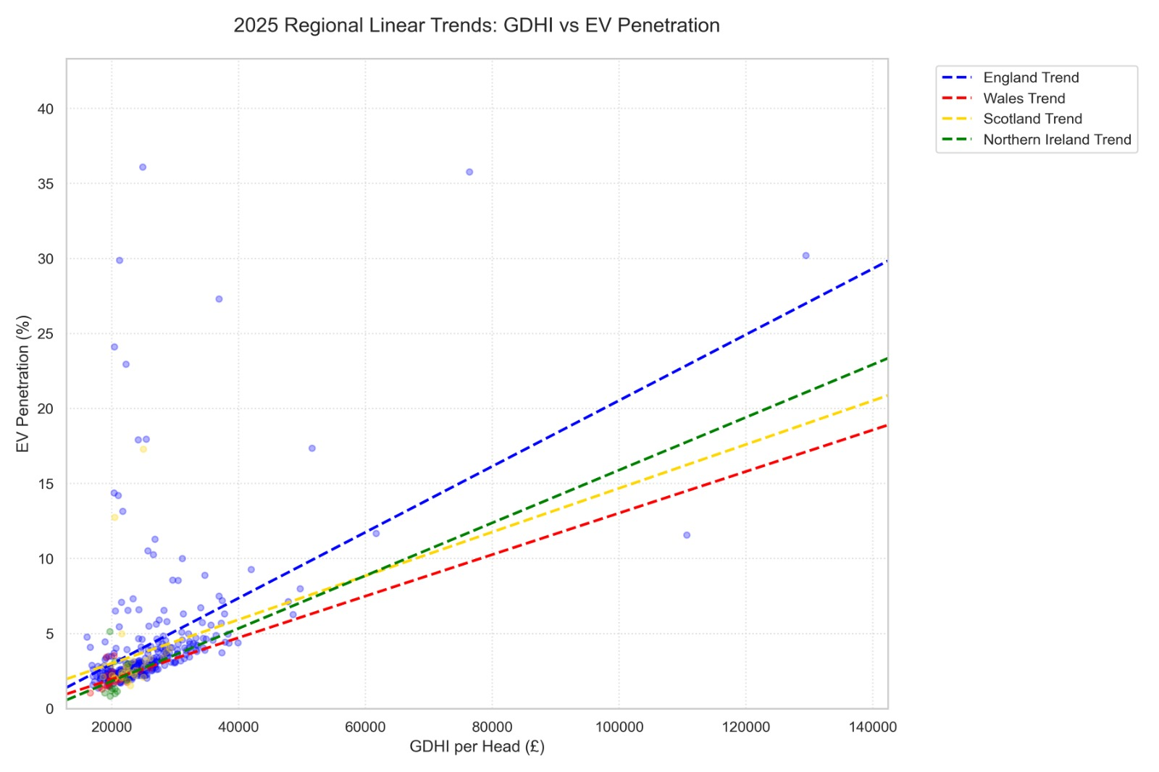
The Wealth Constraint
Car Ownership Paradox: London has the lowest vehicle ownership (<3,000/10k people) but the one of highest EV penetration (10.8%). This stark contrast indicates a distinct, wealthier demographic of early adopters.
Premium Reality: EVs are premium goods strictly bottlenecked by absolute purchasing power; policy intervention is mathematically required.
Call to Action: Because adoption is bottlenecked by absolute purchasing power, targeted policy intervention is mathematically required.

Slide 5
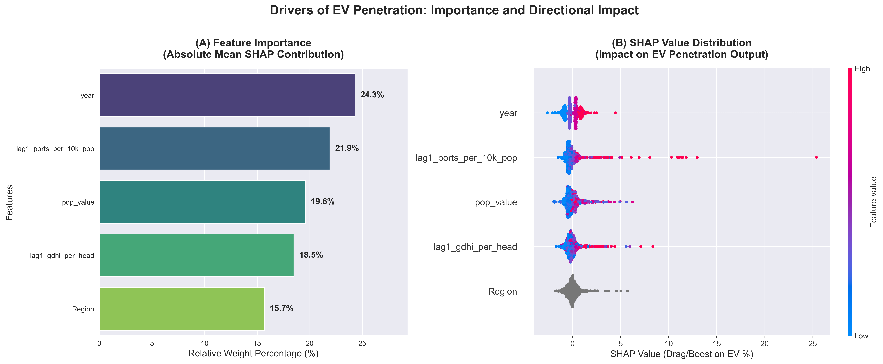
Feature Importance Attribution
Methodology: We utilized XGBoost to capture complex non-linear relationships, integrated with the SHAP framework to precisely quantify global marginal contributions.
Key Drivers: Outside of the natural progression of time, Lagged Charging Port Density (21.9%) and Per Capita GDHI (18.5%) emerge as the absolute dominant drivers. (Population scale follows at 19.6%).
Impact Direction: High income and dense infrastructure exert a powerful positive stimulus on EV penetration, with charging ports creating a distinct long-tail acceleration effect.

Slide 6
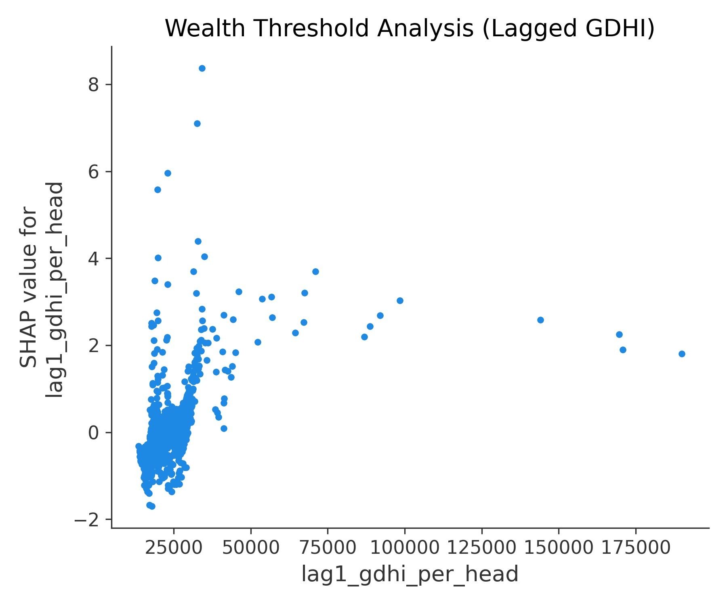
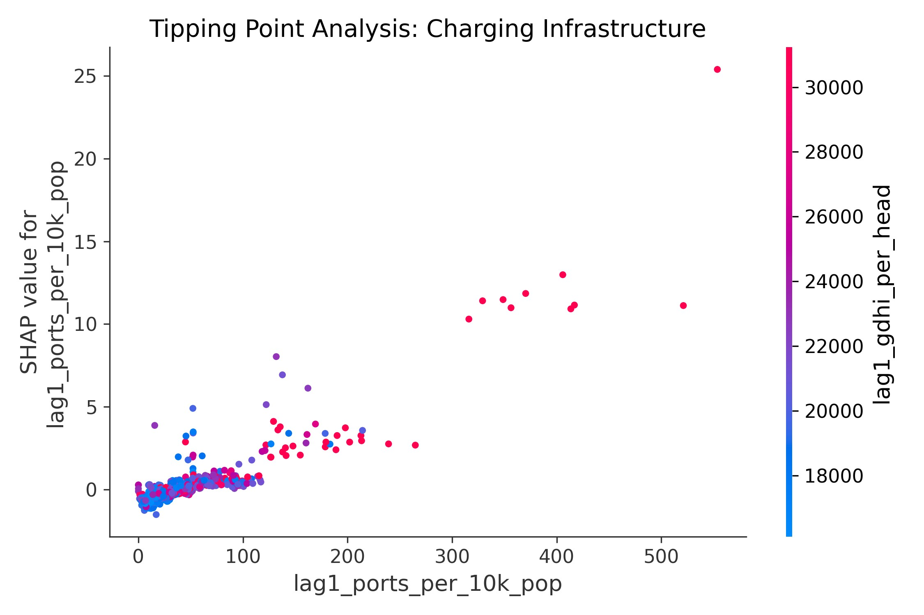
Unlocking Tipping Points
The Wealth Prerequisite:
GDHI acts as a massive accelerator, but only after crossing a critical £20,000–£35,000 per capita threshold.
The Infrastructure Threshold:
The plot proves that adding public chargers in low-adoption areas is ineffective until density crosses a critical mathematical mass of 100-150 ports per 10k people.

Slide 7
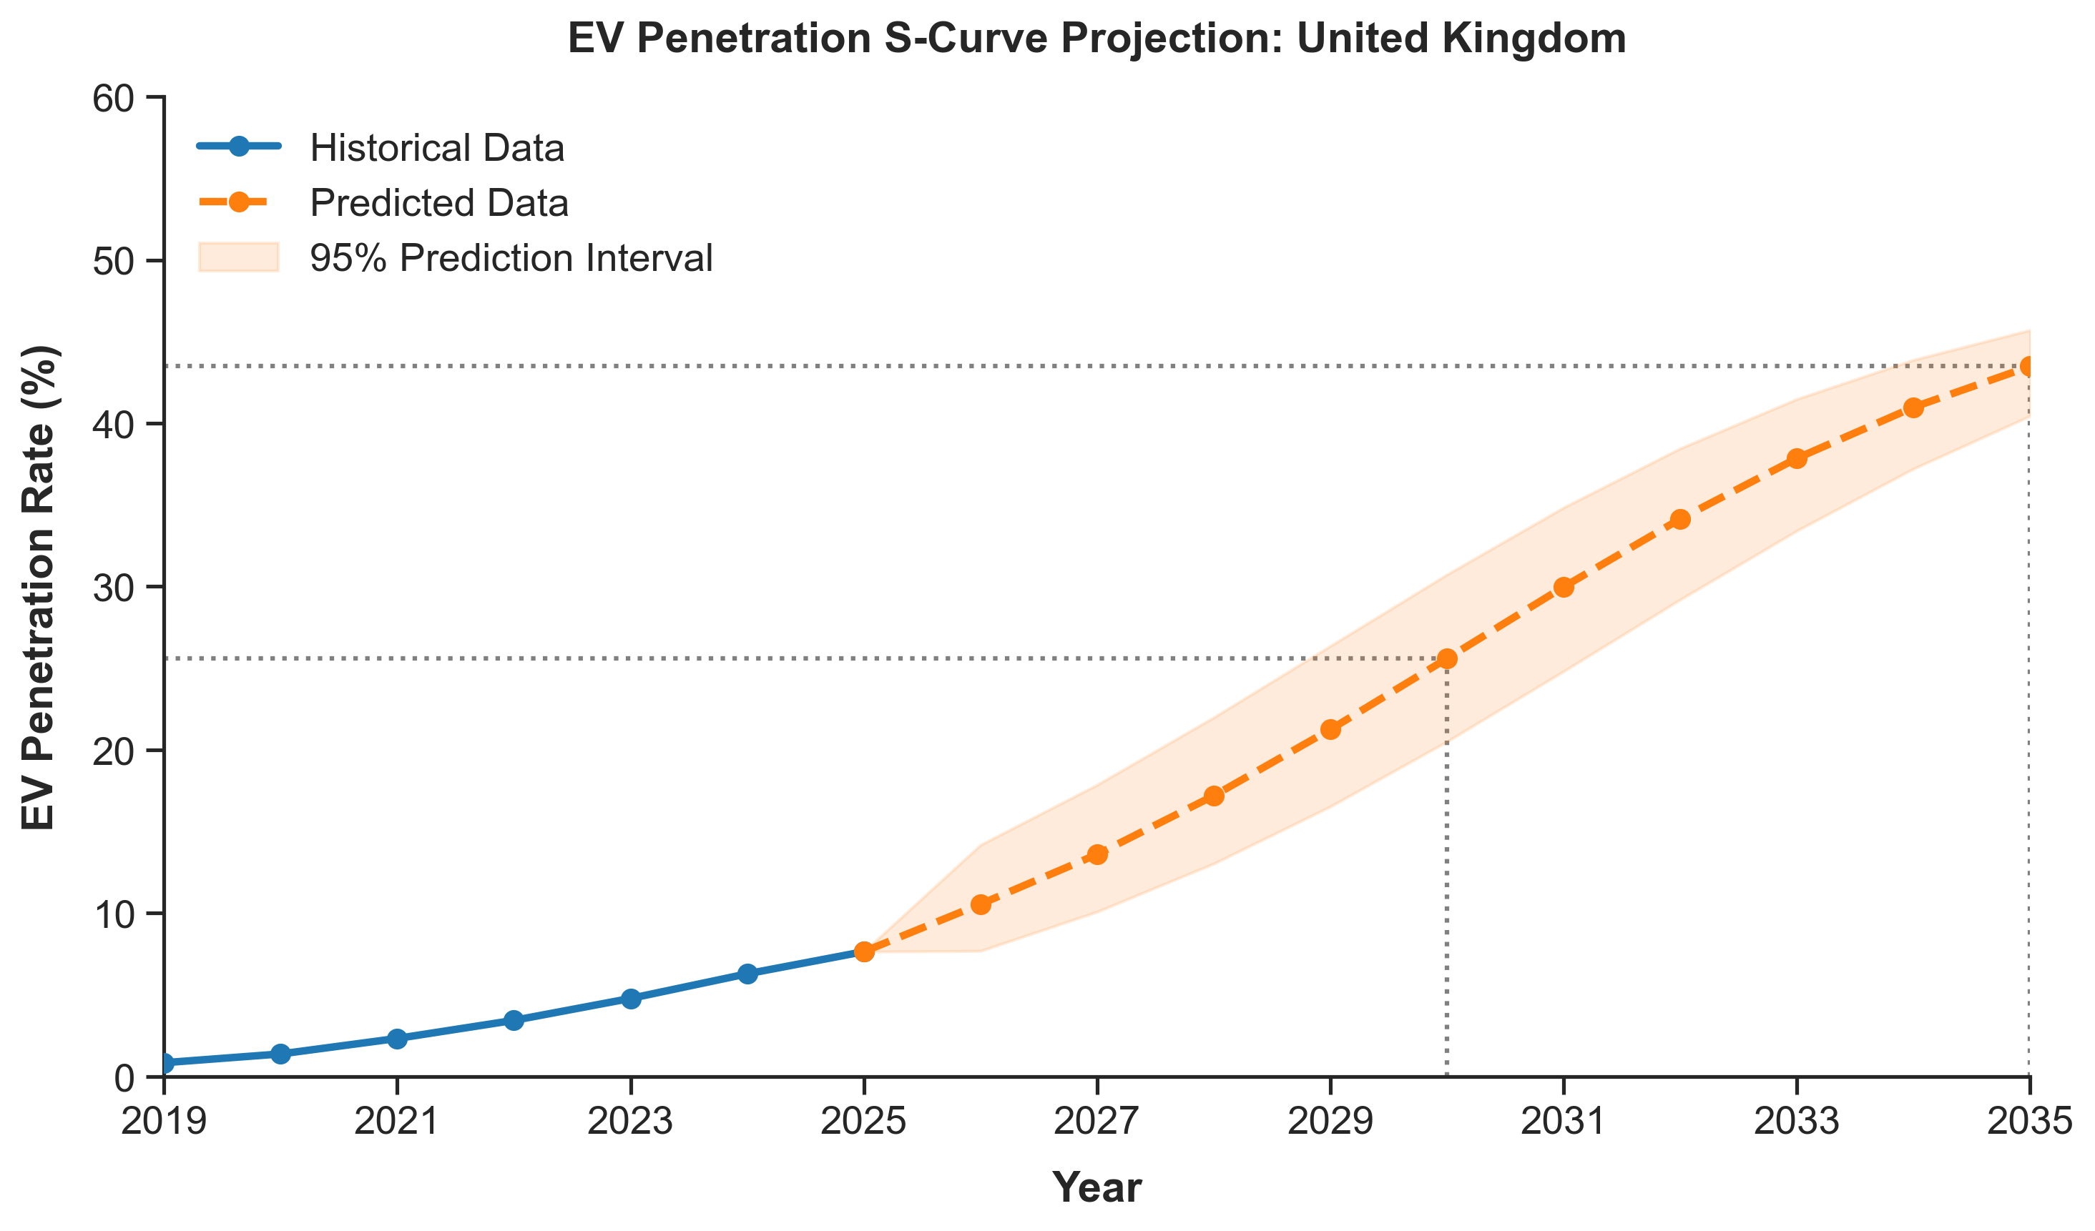
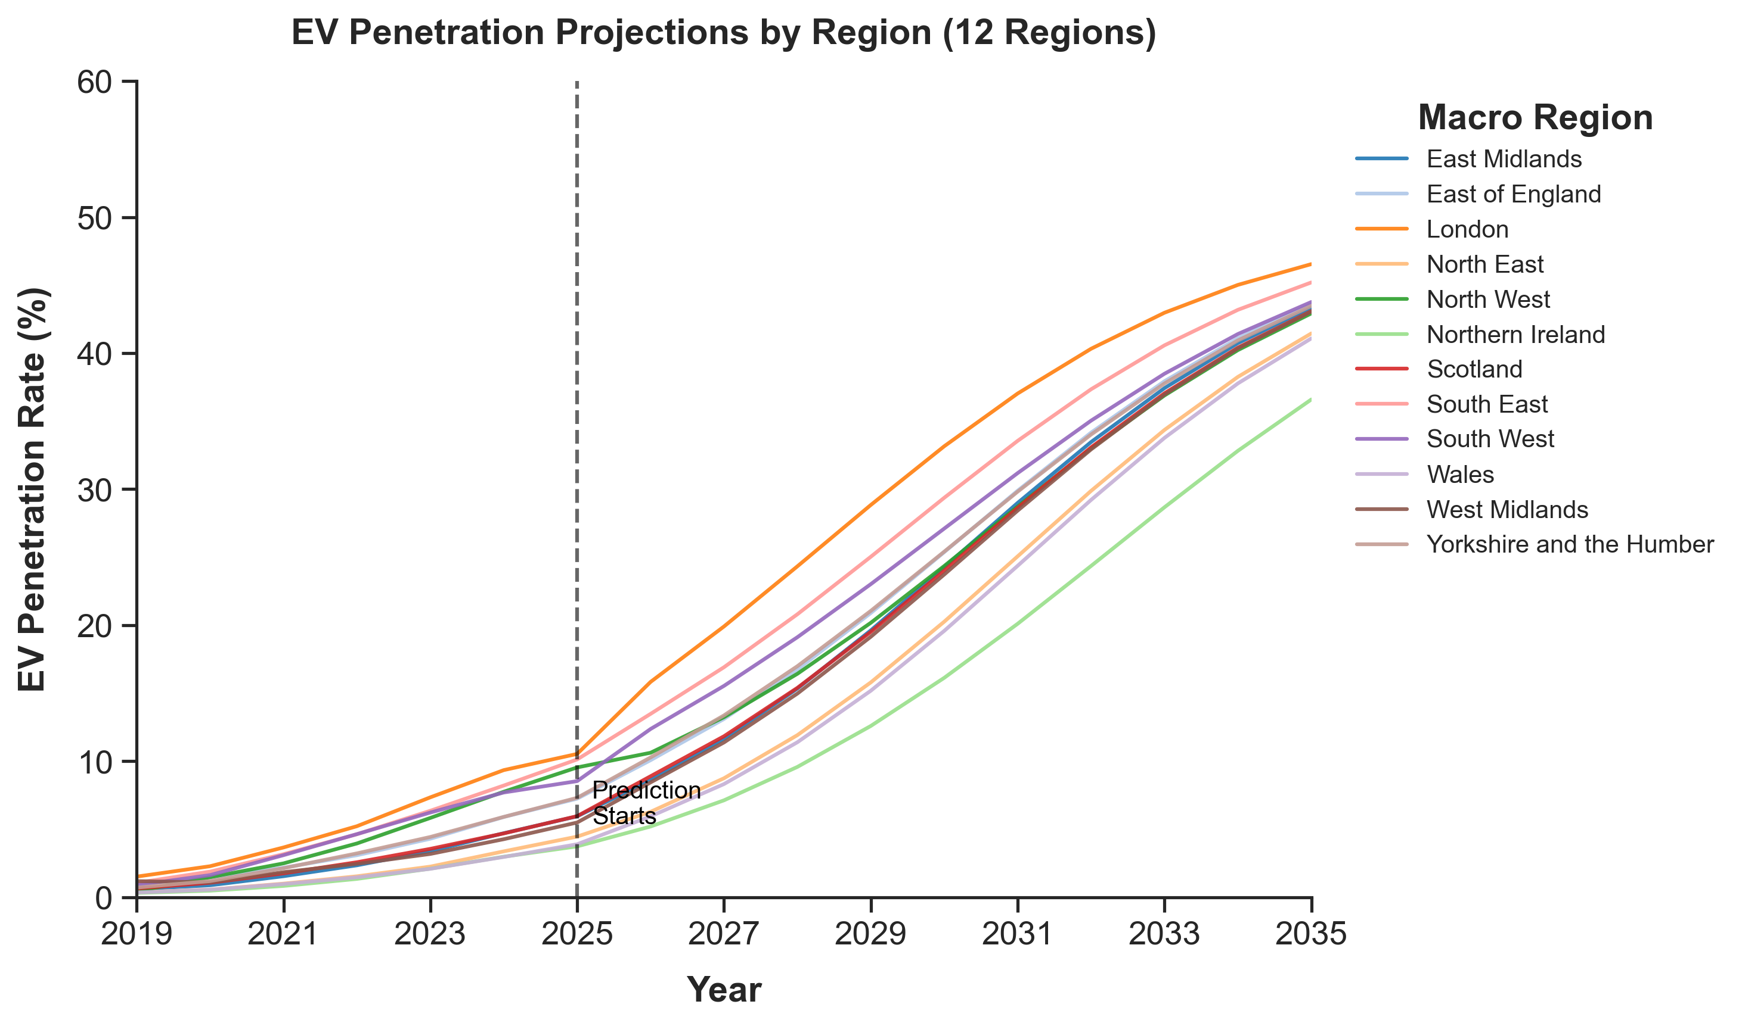

The Forecasting Engine
Model Selection: We rejected tree-based algorithms (lack of time-extrapolation) and linear regression (impossible >100% predictions).
Mathematical Transformation: We mapped real-world percentages into a Logit kinetic space using
$Y_{i, t}=ln\left(\frac{P_{i,t}}{50.24\%−P_{i,t}}\right)$
The Physical Ceiling: Constrained by the 14-year vehicle scrappage cycle, this formula forces adoption rates to naturally decelerate as they approach a strict 50.24% fleet ceiling.
Base Parameter: To prevent population/vehicle decoupling in the 2035 forecast, we locked the regional car-per-capita drift rate to a strict $±0.5\%$annual variance.

Slide 8
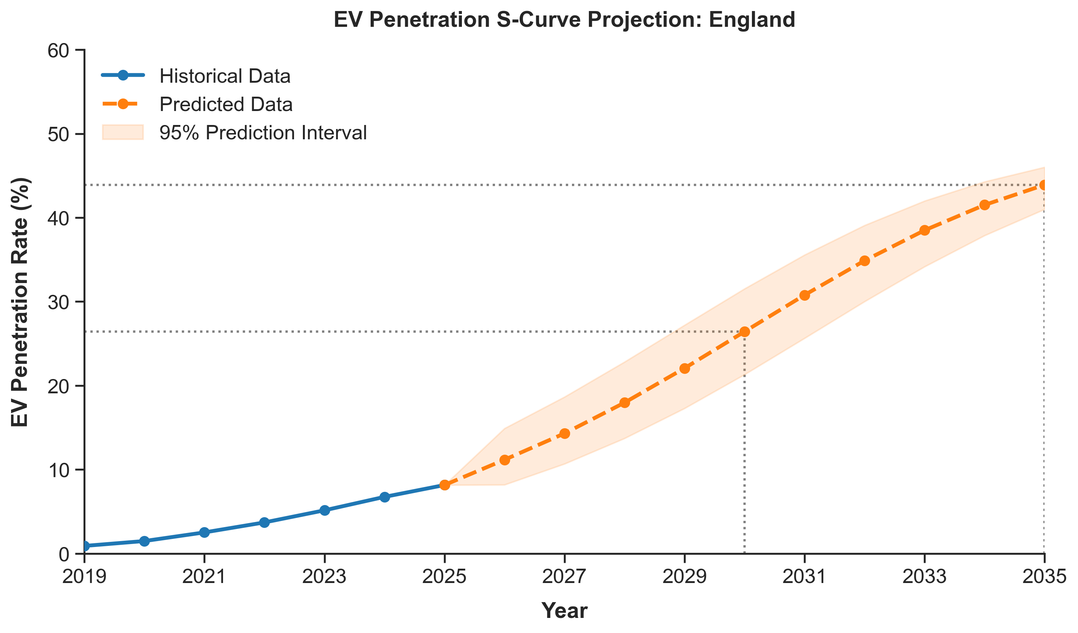
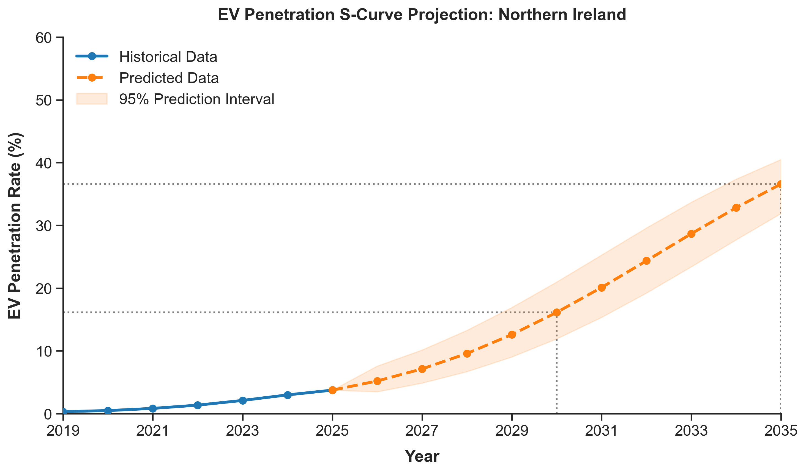
The 2035 Regional Extremes
UK Macro Trend: Follows a standard S-Curve logistic growth trajectory.
The Leader (England): Skews the national average upward, driven by localized wealth and early infrastructure scaling.
The Laggard (Northern Ireland): Plunges into an early plateau. Without intervention, it will struggle to break 30% fleet penetration by 2035.

Slide 9
Strategic Recommendations
Conclusion: A "one-size-fits-all" national policy structurally fails to close the geographic gap.
Asymmetric Subsidies: Redirect purchase grants strictly toward economically weaker "long-tail" regions (Wales and NI).
Targeted Infrastructure: Prioritize public charger density in urban centres which reach GHDI per capita threshold to rapidly breach the 150 ports/10k tipping point.
Marketing Pivot: Automakers must transition from "selling vehicles" to "selling premium green replacements."

Slide 10
Team Contributions & Q&A
Team Member | Core Project Responsibilities
[All Members] | Data Cleaning & Preprocessing
[Chenxi Hu, Yuan Lu] | Exploratory Analysis
[Jipeng Song, Yiding Wang] | Feature Weight Analysis & Forecasting Engine
[All Members] | Visualization
[Yiding Wang] | Strategic Recommendations

